Slide 1
PX5710/PX5718
Statistics and Time Series Analysis
Inferential Statistics – Part 2
χ² test and distributions
2025-26 Term 2
Department of Physics
Dr. Andrew Angel andrew.angel@abdn.ac.uk Meston 339
Dr Sandip George sandip.george@abdn.ac.uk Fraser Noble 141

Slide 2
Null Hypothesis Significance Testing
What are the assumptions of the test?
What is the parameter of interest?
What is the null hypothesis?
What is the test statistic?
What is the distribution of the test statistic under the null hypothesis?
For a specific α- level, can we reject the null hypothesis?
t-test: Independence of observations, Normality, continuous scale measurement
t-test: means of the samples
t-test: means of the samples do not significantly differ
t-test: t-statistic
t-test: t statistic distribution
t-test: probability of t-statistic in the distribution > observed t-statistic, is less than α

Slide 3
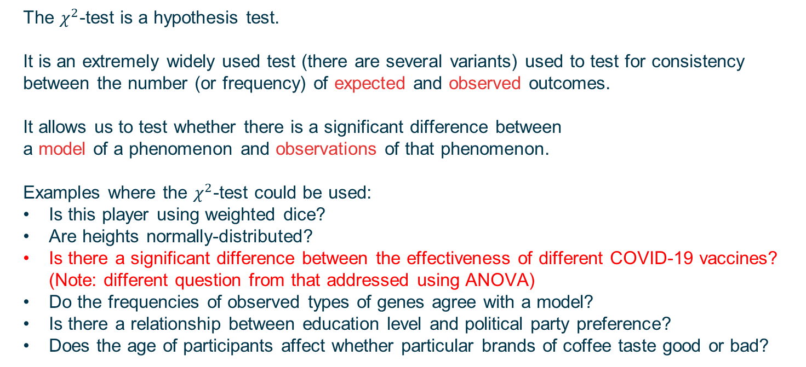
$χ^{2}$(chi-squared)-tests
The $χ^{2}$-test is a hypothesis test.
It is an extremely widely used test (there are several variants) used to test for consistency between the number (or frequency) of expected and observed outcomes.
It allows us to test whether there is a significant difference between
a model of a phenomenon and observations of that phenomenon.
Examples where the $χ^{2}$-test could be used:
Is this player using weighted dice?
Are heights normally-distributed?
Is there a significant difference between the effectiveness of different COVID-19 vaccines? (Note: different question from that addressed using ANOVA)
Do the frequencies of observed types of genes agree with a model?
Is there a relationship between education level and political party preference?
Does the age of participants affect whether particular brands of coffee taste good or bad?

Slide 4
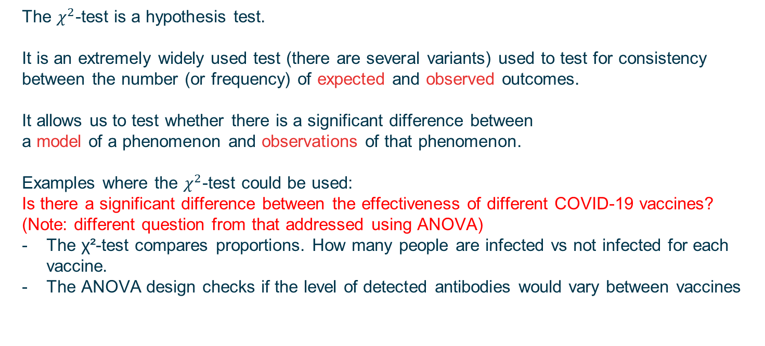
$χ^{2}$(chi-squared)-tests
The $χ^{2}$-test is a hypothesis test.
It is an extremely widely used test (there are several variants) used to test for consistency between the number (or frequency) of expected and observed outcomes.
It allows us to test whether there is a significant difference between
a model of a phenomenon and observations of that phenomenon.
Examples where the $χ^{2}$-test could be used:
Is there a significant difference between the effectiveness of different COVID-19 vaccines? (Note: different question from that addressed using ANOVA)
The χ²-test compares proportions. How many people are infected vs not infected for each vaccine.
The ANOVA design checks if the level of detected antibodies would vary between vaccines

Slide 5
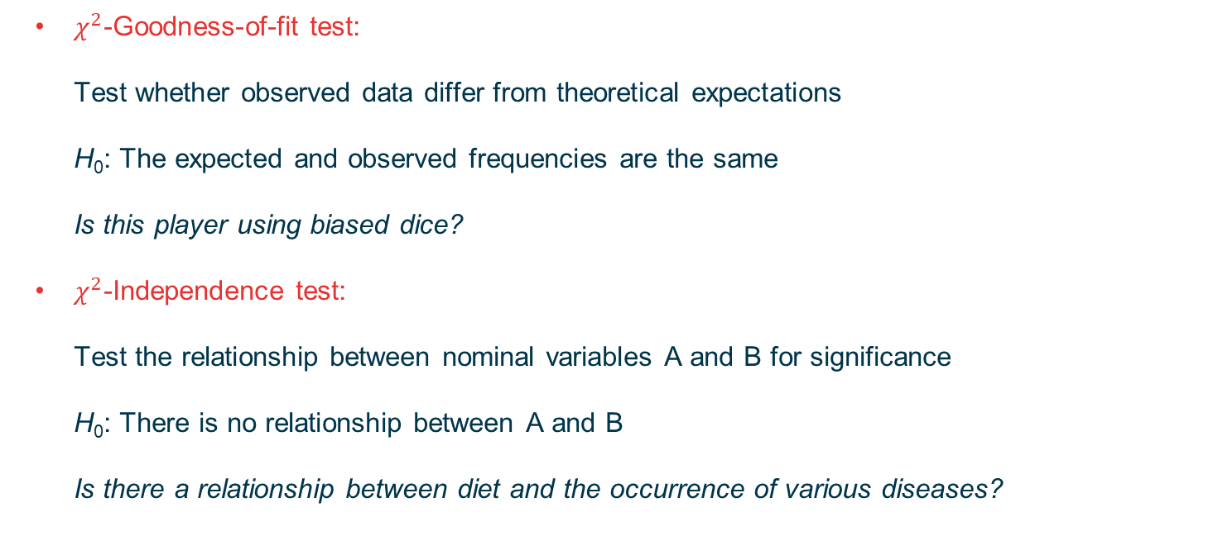
Main uses for the $χ^{2}$-test
$χ^{2}$-Goodness-of-fit test: Test whether observed data differ from theoretical expectations H₀: The expected and observed frequencies are the same Is this player using biased dice?
$χ^{2}$-Independence test: Test the relationship between nominal variables A and B for significance H₀: There is no relationship between A and B Is there a relationship between diet and the occurrence of various diseases?

Slide 6
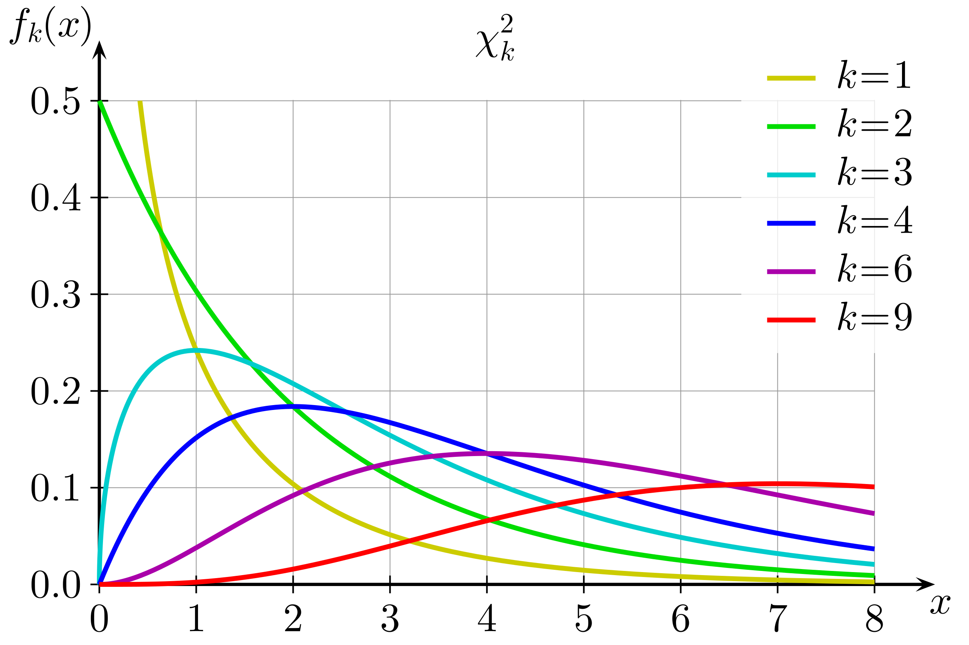
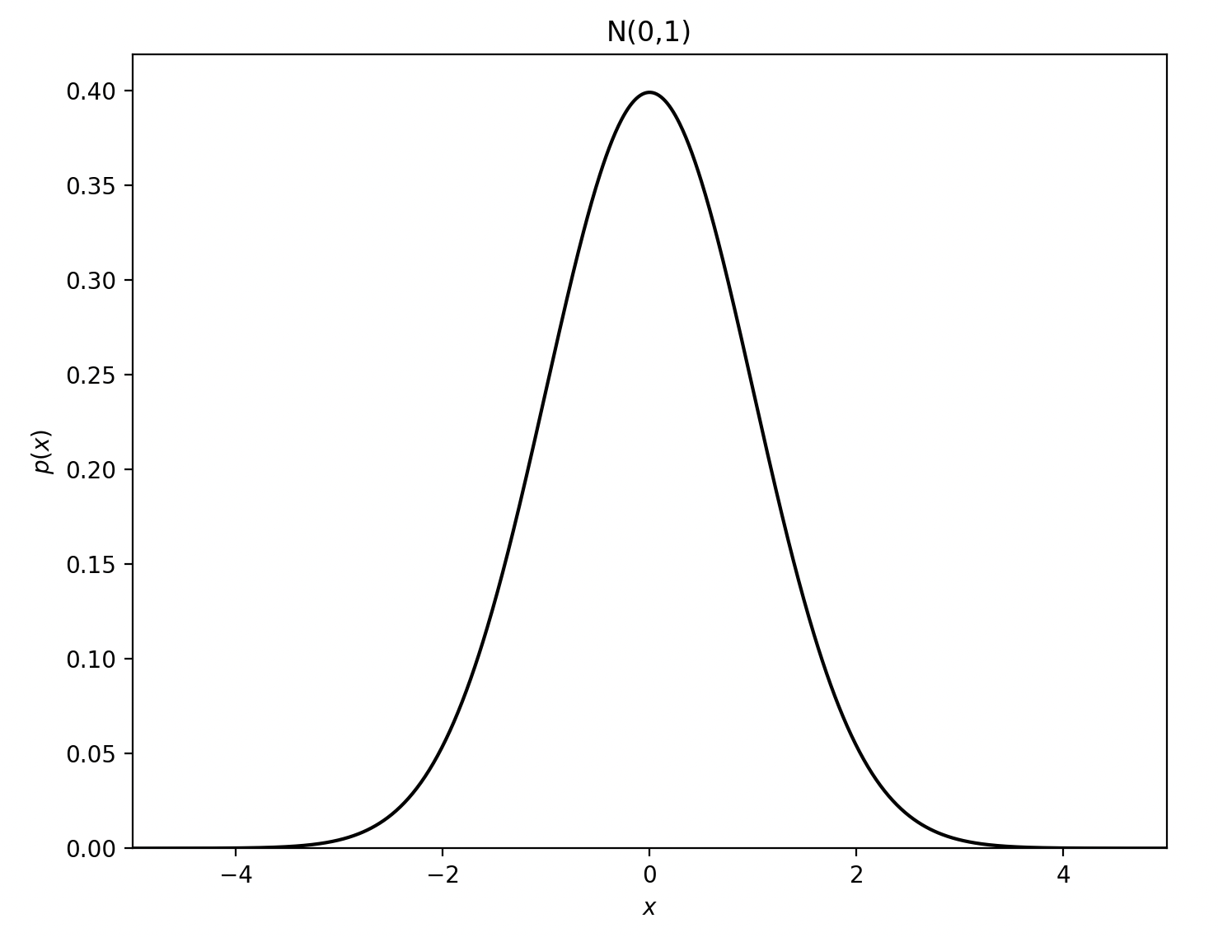
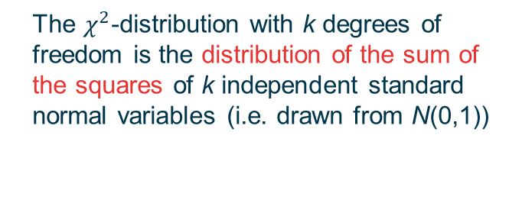
The $χ^{2}$-distribution
The difference between expected and observed frequencies follows a $χ^{2}$-distribution
The $χ^{2}$-distribution with k degrees of freedom is the distribution of the sum of the squares of k independent standard normal variables (i.e. drawn from N(0,1))
[Geek3/CC BY 3.0]

Slide 7
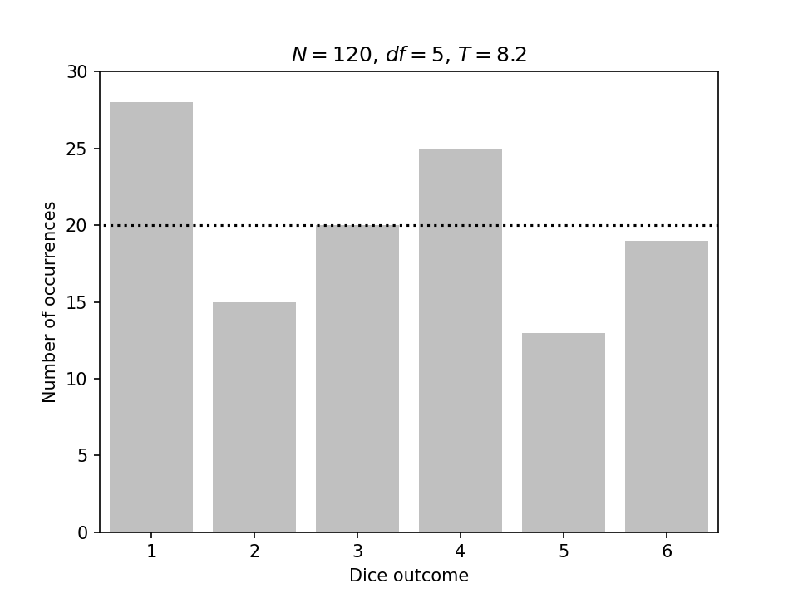
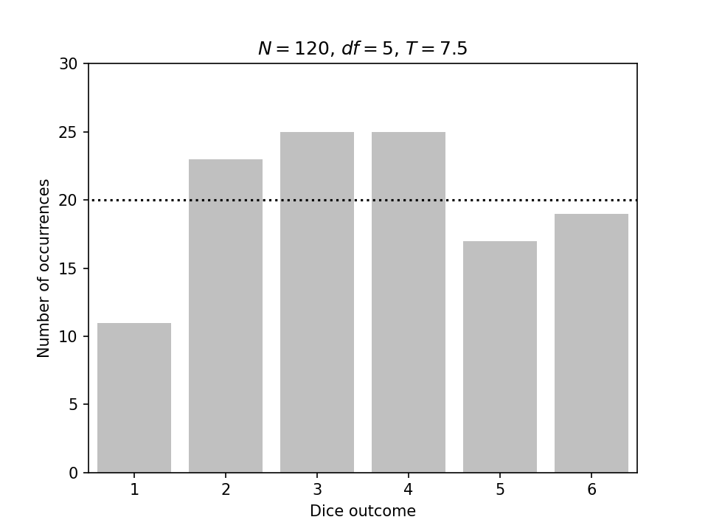
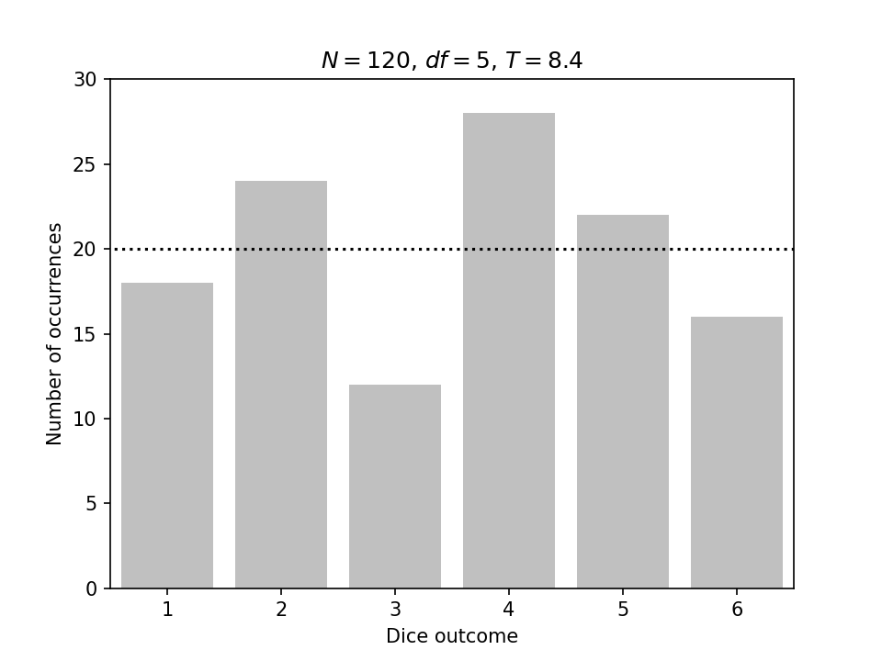
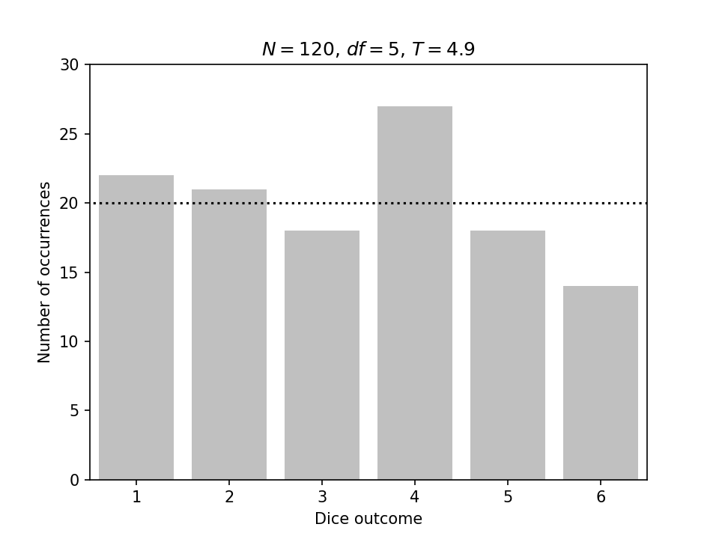
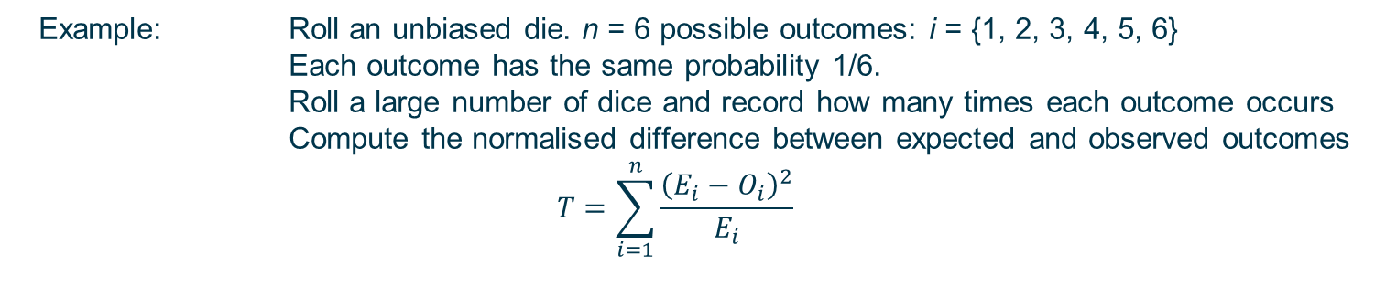

The difference between expected and observed frequencies follows a $χ^{2}$-distribution
Example: Roll an unbiased die. n = 6 possible outcomes: i = {1, 2, 3, 4, 5, 6}
Each outcome has the same probability 1/6.
Roll a large number of dice and record how many times each outcome occurs
Compute the normalised difference between expected and observed outcomes
$$T=\sum_{i=1}^{n}{\frac{{\left(E_{i}−O_{i}\right)}^{2}}{E_{i}}}$$
Each sample contains 120 dice. Expect 20 of each outcome.
Sample 1, T = 8.2
Sample 2, T = 7.5
Sample 3, T = 8.4
Sample 4, T = 4.9

Slide 8
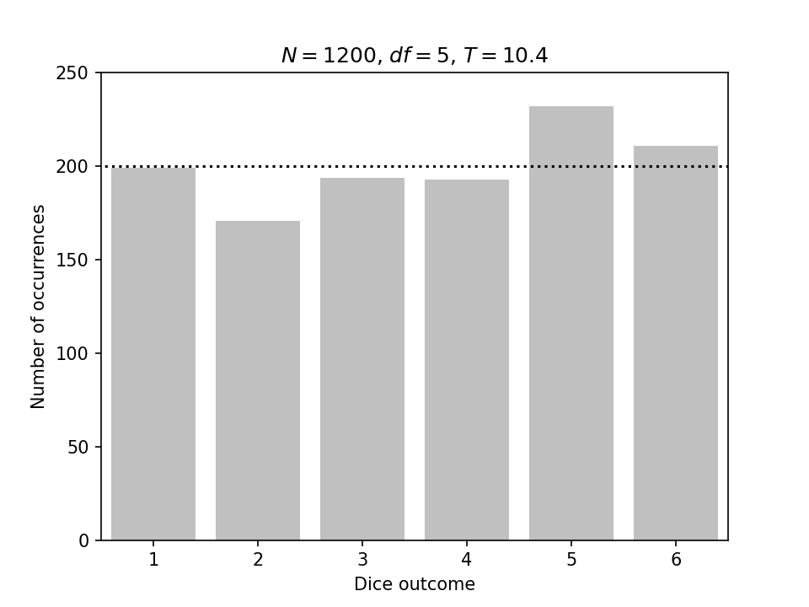
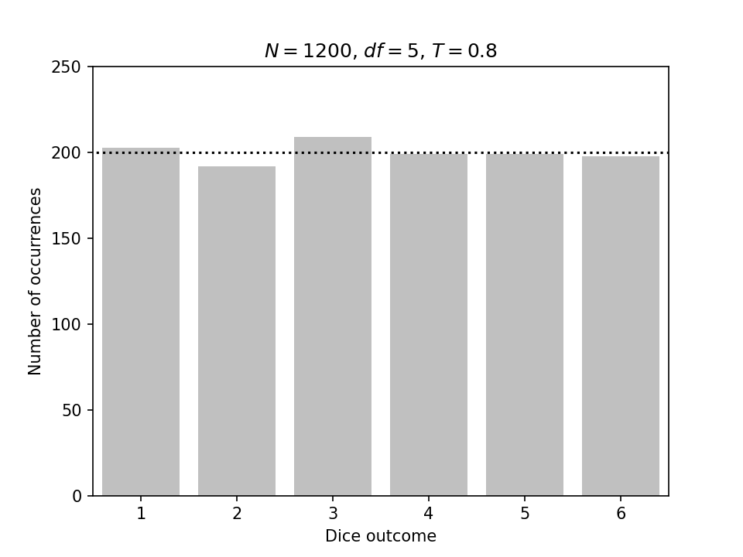
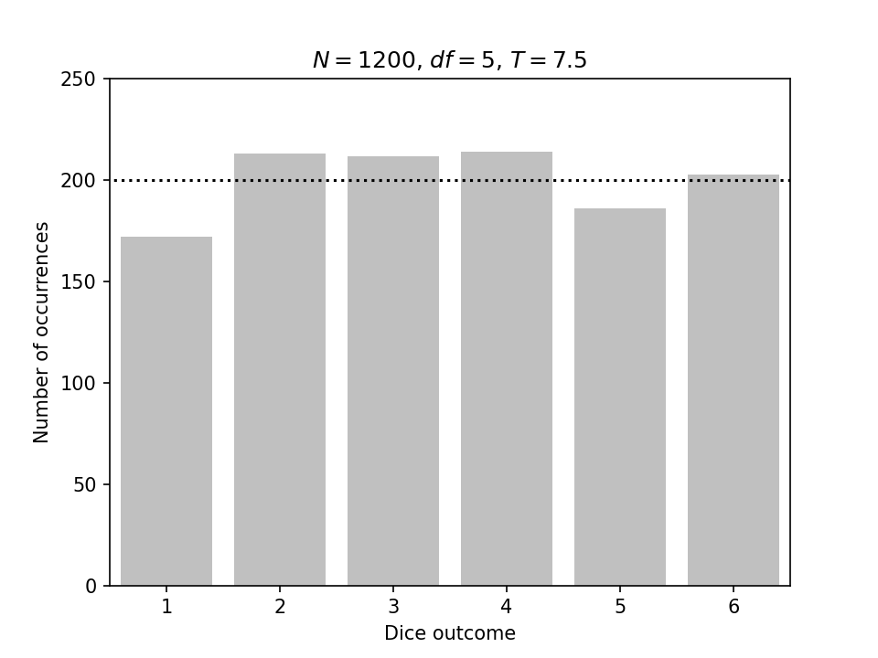
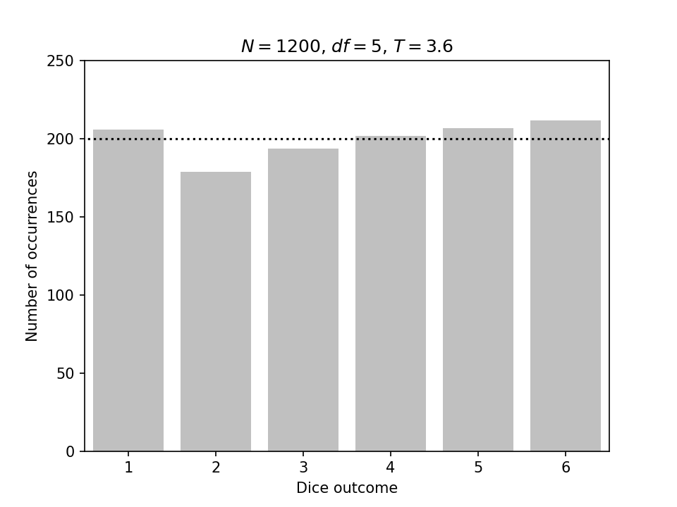
The difference between expected and observed frequencies follows a $χ^{2}$-distribution
Example: Roll an unbiased die. n = 6 possible outcomes: i = {1, 2, 3, 4, 5, 6}
Each outcome has the same probability 1/6.
Roll a large number of dice and record how many times each outcome occurs
Compute the normalised difference between expected and observed outcomes
$$T=\sum_{i=1}^{n}{\frac{{\left(E_{i}−O_{i}\right)}^{2}}{E_{i}}}$$
Each sample contains 1200 dice. Expect 200 of each outcome.
Sample 1, T = 10.4
Sample 2, T = 0.8
Sample 3, T = 7.5
Sample 4, T = 3.6

Slide 9
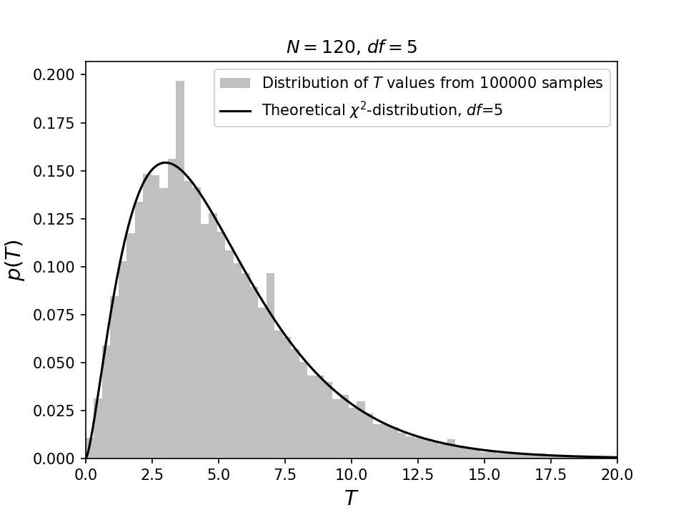
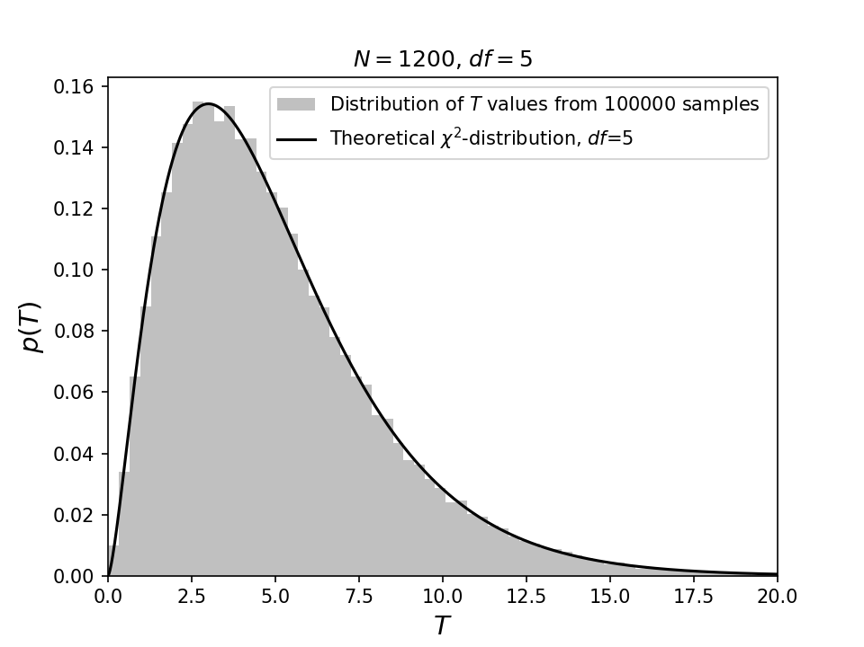
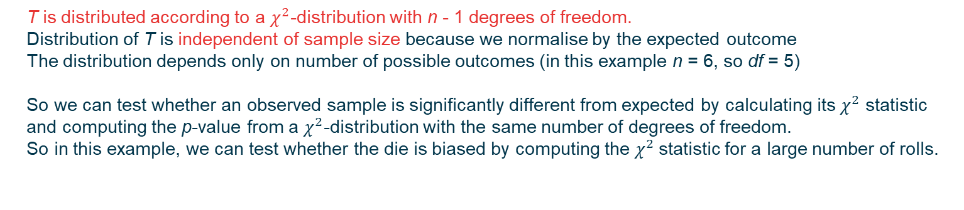
The difference between expected and observed frequencies follows a $χ^{2}$-distribution
T is distributed according to a $χ^{2}$-distribution with n - 1 degrees of freedom.
Distribution of T is independent of sample size because we normalise by the expected outcome
The distribution depends only on number of possible outcomes (in this example n = 6, so df = 5)
So we can test whether an observed sample is significantly different from expected by calculating its $χ^{2}$ statistic and computing the p-value from a $χ^{2}$-distribution with the same number of degrees of freedom.
So in this example, we can test whether the die is biased by computing the $χ^{2}$statistic for a large number of rolls.

Slide 10
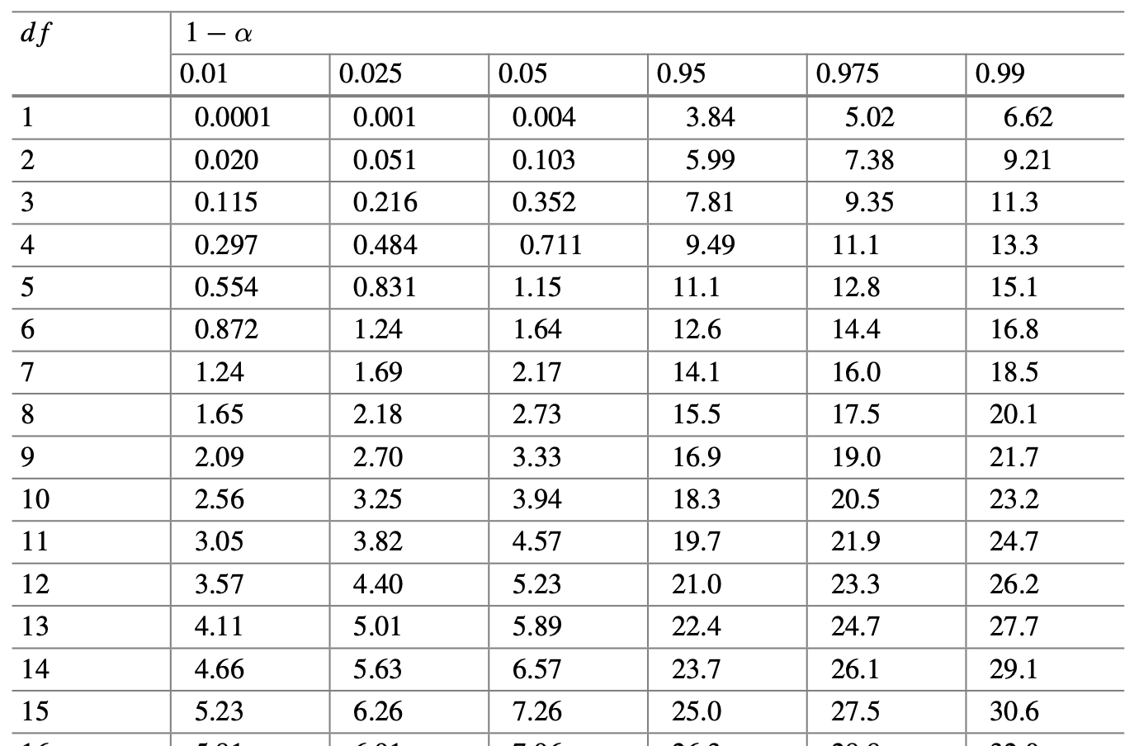


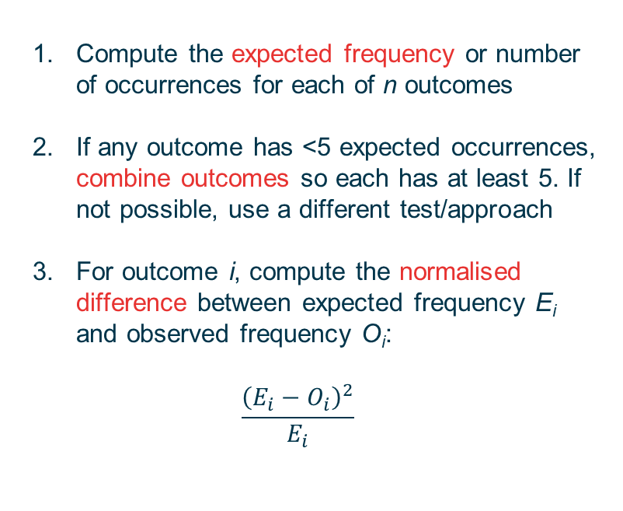
$χ^{2}$-test procedure
Compute the expected frequency or number of occurrences for each of n outcomes
If any outcome has <5 expected occurrences, combine outcomes so each has at least 5. If not possible, use a different test/approach
For outcome i, compute the normalised difference between expected frequency E_{i} and observed frequency O_{i}:
$$\frac{{\left(E_{i}−O_{i}\right)}^{2}}{E_{i}}$$
Critical values for the $χ^{2}$ distribution
Heumann et al. (2023) p.569
Note that for the test to be valid, each observation can contribute to the count for a single outcome only
– outcomes must be independent of each other.

Slide 11
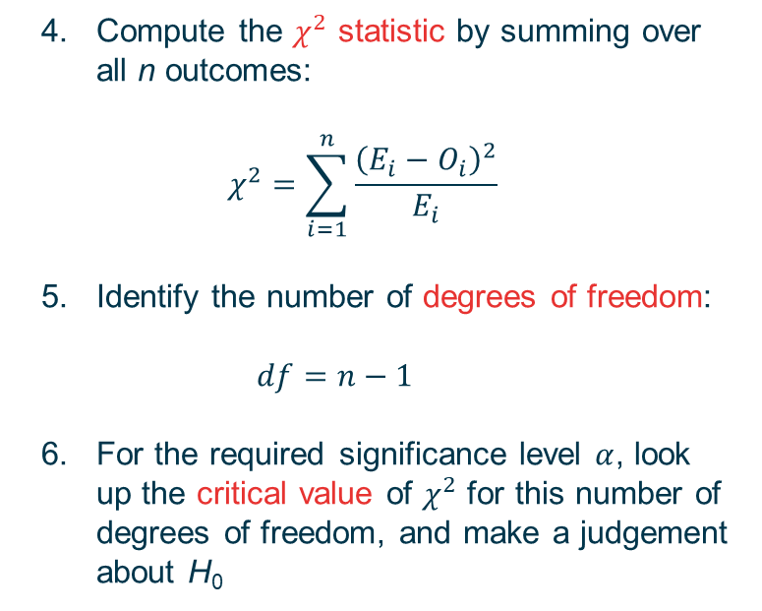
$χ^{2}$-test procedure
Compute the $χ^{2}$ statistic by summing over all n outcomes:
$$χ^{2}=\sum_{i=1}^{n}{\frac{{\left(E_{i}−O_{i}\right)}^{2}}{E_{i}}}$$
Identify the number of degrees of freedom: $df=n−1$
For the required significance level $α$, look up the critical value of $χ^{2}$ for this number of degrees of freedom, and make a judgement about H₀
Critical values for the $χ^{2}$ distribution
Heumann et al. (2023) p.569
Examples: 04_chi2_goodness_of_fit.nb
05a_chi2_independence_hands_on.nb

